Slide 1

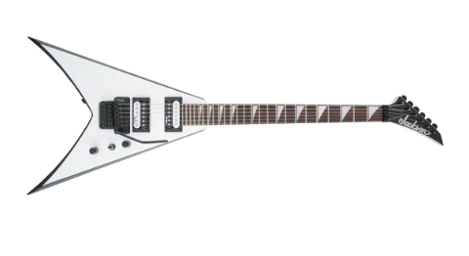
Introduction to Bare Bear Metal on MP13
Bear Photo : Byrdyak

Slide 2
Agenda
#
Topic
#
Topic
#
Topic
#
Topic
#
Topic
#
Topic
#
Topic
#
Topic

Slide 3
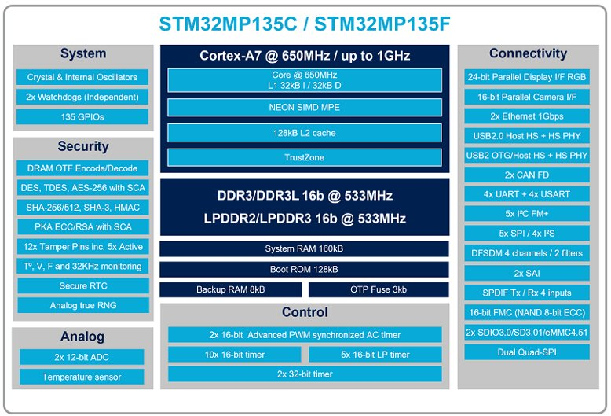
What is an STM32MP13?
Cortex A7 (ARMv7-A) architecture
L1 I & D Caches
Level2 Cache
Arm TrustZone security technology
Arm NEON advanced SIMD
DSP and SIMD extensions
VFPv4 floating-point
DDR controller
Connectivity / Analog Peripherals
Much More!

Slide 4
Supplied Tools & Motivations
The Bare Metal distribution brings MCU simplicity to MPU performance
It allows (forces) the application to manage the hardware resources with no OS
Provides suitable framework for platform validation SW harness
Tools and Distributions referenced in this slide deck
HAL_MP13_V1.0.0
https://www.st.com/en/embedded-software/stm32cubemp13.html
CubeIDE V 1.13.0
https://www.st.com/en/development-tools/stm32cubeide.html#
CubeProgrammer V 2.14.0
https://www.st.com/en/development-tools/stm32cubeprog.html
Starter Package for OSTL on MP13DK
https://www.st.com/en/embedded-software/stm32mp1starter.html#get-software

Slide 5
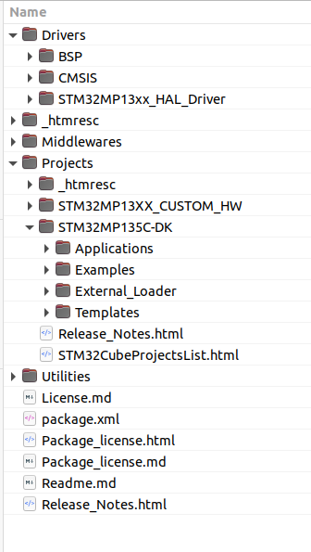
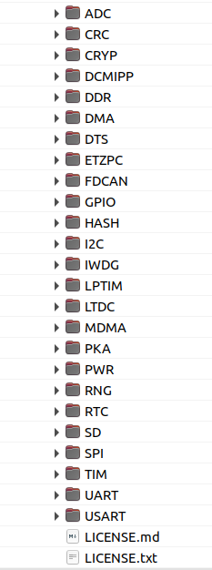
Components of the Bare Metal Package
The HAL release for MP13 allows for Bare Metal application creation
The distribution includes
CMSIS device implementation
Core related files for the device
Peripheral Drivers
Drivers for each of the HW peripherals
Example Projects
Small examples for peripheral usage
Application Projects
Combine multiple aspects of the HW and SW in single project

Slide 6
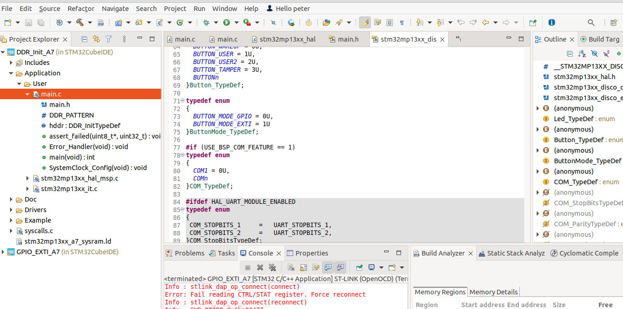
CubeIDE
ST Integrated Development Environment
Based on Eclipse IDE
Source Editor
Build Management
Debugger
Code Generation
Integrated CubeMX
Linux Device Trees (today)

Slide 7
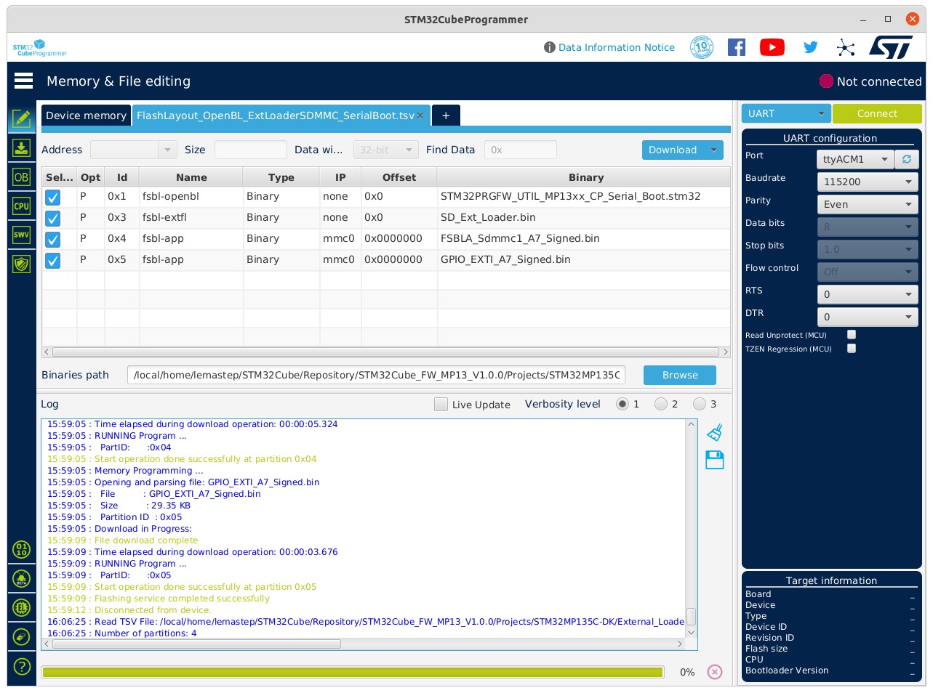
CubeProgrammer
ST Utility to ease programming of embedded memory on platforms
Visualization of what is to be programmed
Programming
Interface Selection
Programming layout Config File
Real time feedback on the Programming Process

Slide 8
Compiling From the Bare Metal Distro

Slide 9
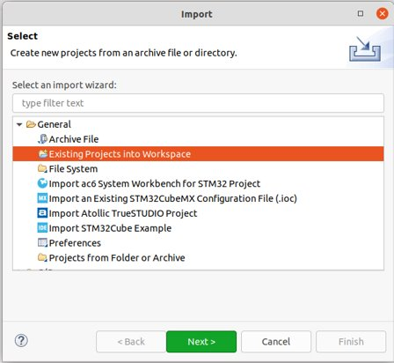
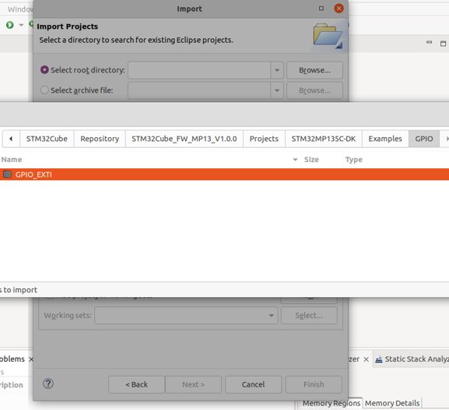
Let's Build Something
Importing an existing Example Project
File -> Import -> Existing Projects Into Workspace
Browse to the installed examples for project path
Use the GPIO_EXTI as an example

Slide 10
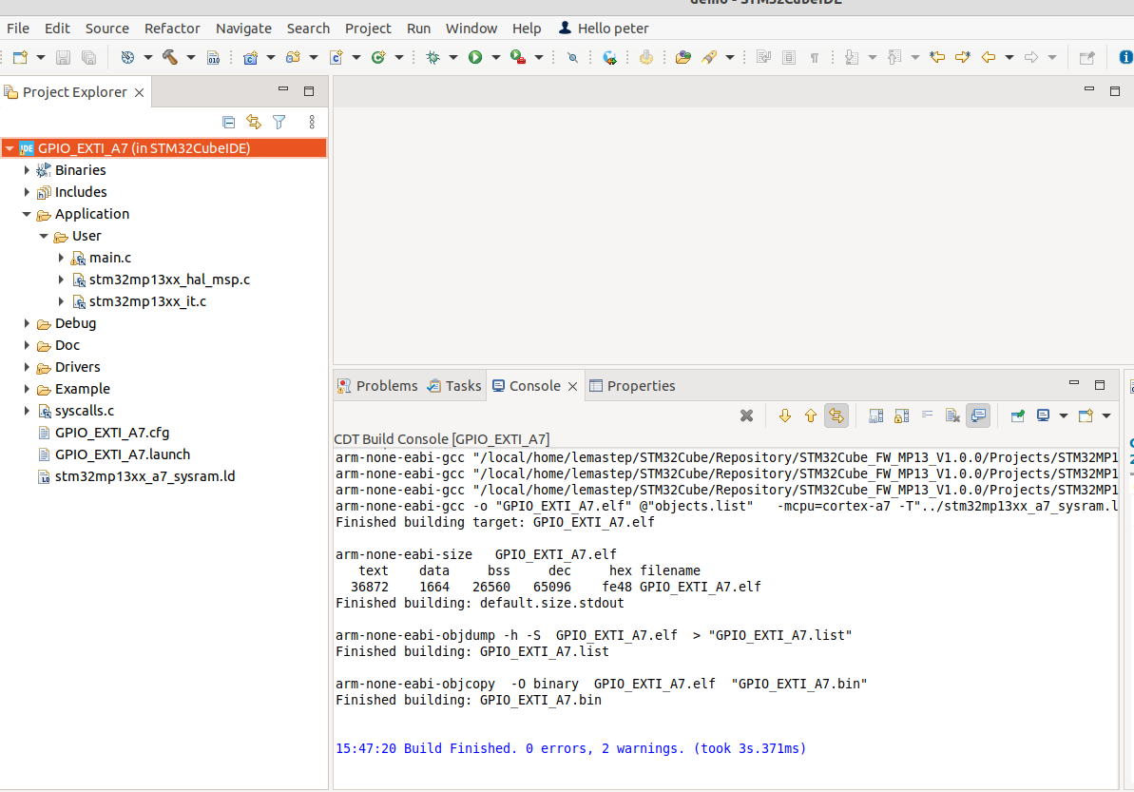
Resulting Project in CubeIDE
New Project exists
Start a Build
Tools Output

Slide 11
STM32MP13-DK Overview

Slide 12
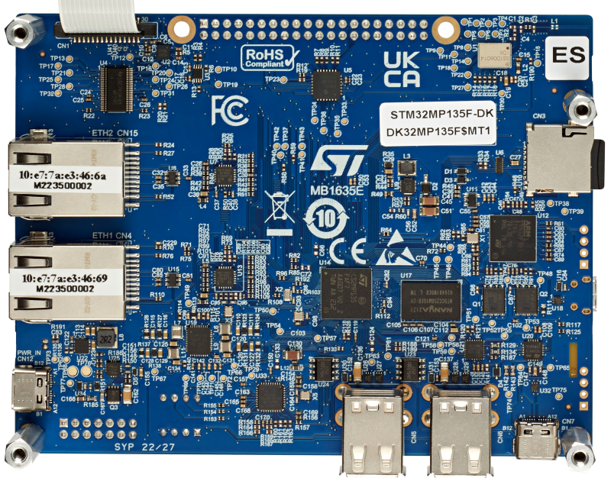
STM32MP13-DK
STM32 MP13 Discovery Kit
STM32MP135F
512M DDR3 (16 bit)
2 x Ethernet 100M
WLAN / Bluetooth
STLink V3 Embedded
USB A
USB C
CSI Camera Interface
4.3" LCD Screen
User Buttons / LEDs
SDCard Interface

Slide 13
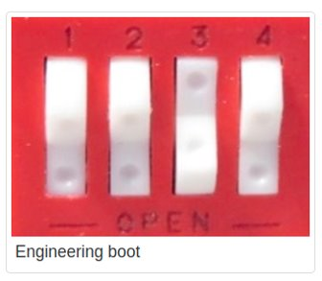
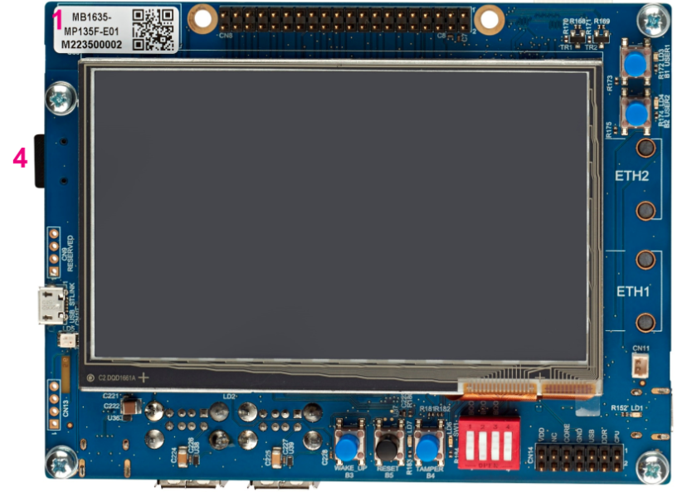
MP13DK Platform Settings
ENGINEERING Boot Configuration
MICRO-USB jack STLink Debug port
USB-C jack (Power Supply)
Underside of board
Boot Pin DIP switch

Slide 14
Debugging an Application

Slide 15
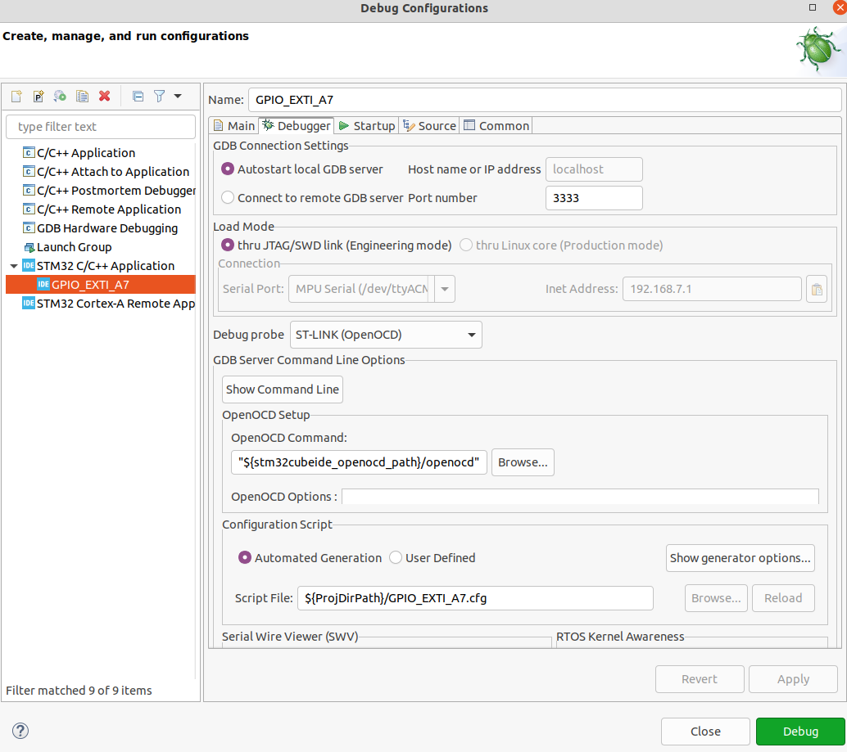
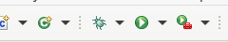
Launch Debug
Once compiled and linked Press the DEBUG button to generate a debug configuration
The defaults are all good but can be modified later from the DEBUG configuration dialog

Slide 16
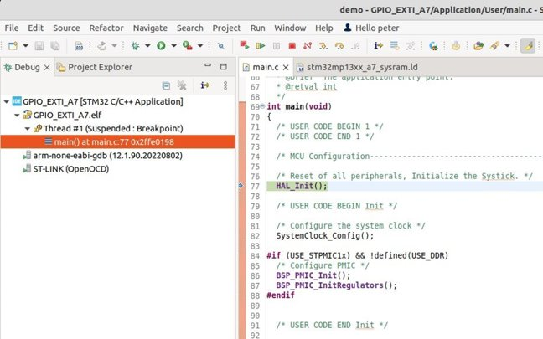
To The Debugger
Prompted to switch to the debug interface
Display of Active Threads
Debug command buttons
Current execution source

Slide 17
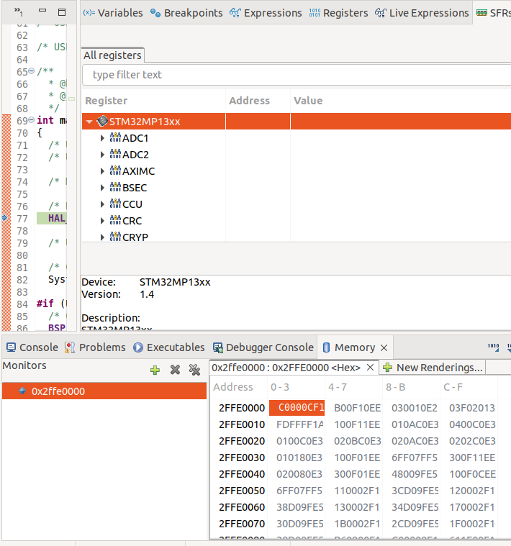
Debug Interface
Additional views
Local variables
Peripheral Registers
Breakpoint display
Memory Windows
etc

Slide 18
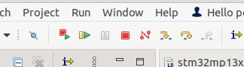
Is This Thing On?
"Run" the application with the "Play" button
GREEN LED toggles with Button USER1

Slide 19
Memory Configurations

Slide 20
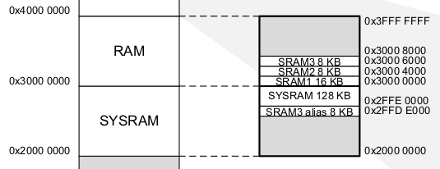
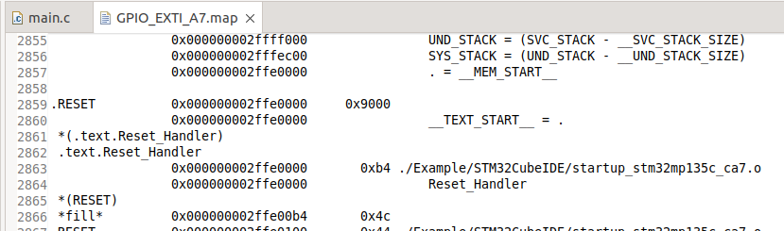
Memory Configurations
By Default
Examples are built for SYSRAM
Let's Look at the output MAP file for the build
code was linked to 0x2FFE0000 (SYSRAM)

Slide 21
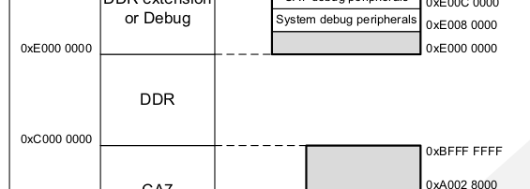
Run from DDR
Compiling for SYSRAM allows for portable example applications
- BUT - what if the application doesn't fit in 128KB
The Platform DDR memory space is also available
MP13DK platform has 512M memory of DDR
To run from DDR
Link start of Memory @ 0xC0000000
Initialize the DDR periph and memory
Once DDR configured, ensure application
doesn’t change DDR voltage rails
doesn’t change DDR clocking

Slide 22
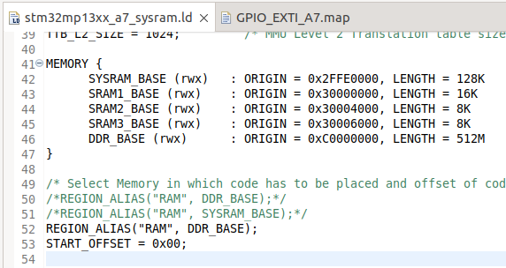
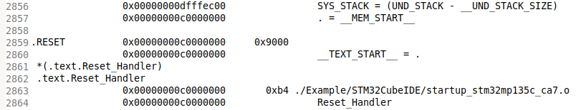
Link start of Memory @ 0xC0000000
Example application link script is stm32mp13xx_a7_sysram.ld
REGION_ALIAS("RAM", SYSRAM_BASE);
Let's modify this to be
REGION_ALIAS("RAM", DDR_BASE);
Re-link the Application
Application now linked @0xC0000000 (DDR)

Slide 23
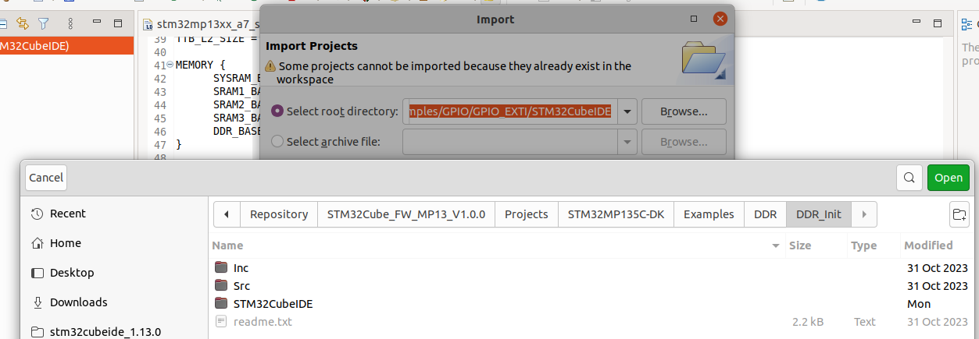
Initialize the DDR periph and memory
DDR_Init application example is provided for DDR memory Initialization
Import an Existing project just like before, but this time for the DDR_Init directory
Rebuild the project with no modifications
Run the project – BLUE LED will start to flash

Slide 24
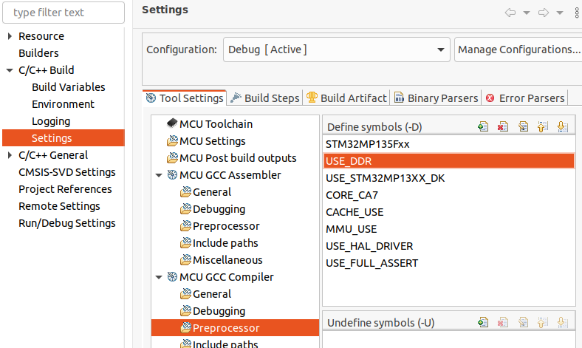
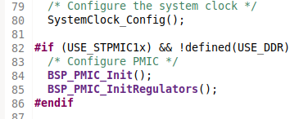
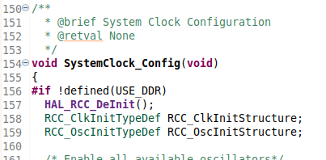
Don't change DDR voltage rails or DDR Clocking
Example applications have !defined(USE_DDR) surrounding PMIC and Clock init
Define this to keep the example app from resetting the DDR config done by DDR_Init
Define USE_DDR for the example application
ProjectProperties -> … -> Settings

Slide 25
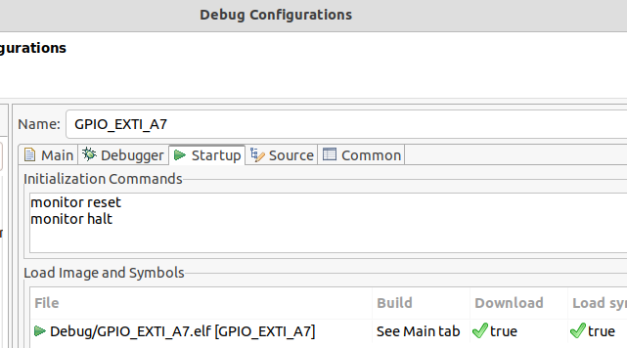
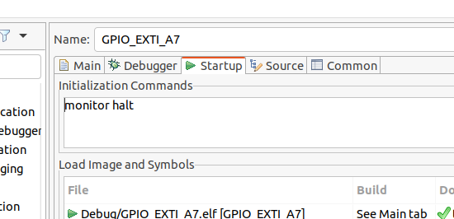
Modify Debug Configuration
Remove the monitor reset call in the debug startup
"monitor reset" will lose the DDR configuration previously established by running DDR_Init

Slide 26
Run From DDR
Full Steps
Compile DDR_Init and run on board
BLUE LED flashing
Modify GPIO_EXTI
Add USE_DDR to defines
Change Link Map to DDR_MEM
Remove "monitor reset" from debug configuration
Debug the GPIO_EXTI project with same results
GREEN LED toggles with Button USER1
Awesome! You're Running From DDR

Slide 27
Boot Capabilities

Slide 28
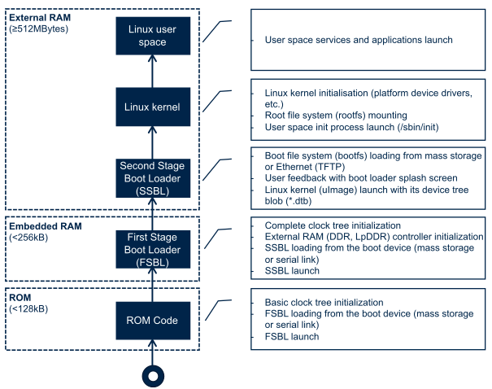
Embedded Linux Boot Phases
ROM code
minimally configures clocks
Configures boot storage device
Jumps to First Stage Bootloader
First Stage Bootloader
Additional clock configuration
DDR configuration
Load second stage bootloader (uboot for Linux)
OR
Load Bare Metal Application

Slide 29
Boot Capabilities
If you want the BOOT ROM to load your binary directly from SDCard
We can use a dedicated FSBL (First Stage Boot Loader)
ROM code needs specific information about the binary to be loaded
This is held in the Binary header, created by the signature step in the build
It is also possible to use the OpenSTLinux boot components as the bootloader
In this case the TF-A and OPTEE binaries would be executed as normal, but the uboot binary would be replaced with the bare metal application

Slide 30
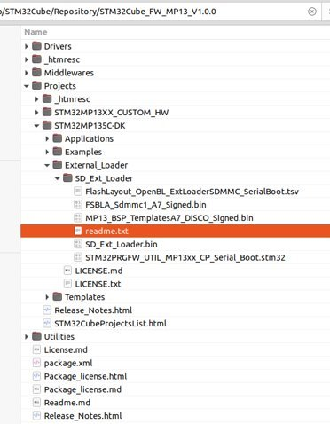
Dedicated FSBL
A dedicated FSBLA application for SDCard is supplied in the HAL distribution
Directory includes the TSV file for CubeProgrammer to flash the Loader and App

Slide 31
Sign the Application
In this case "Signing" the application is not about security
The FSBLA boot loader application needs additional information about the binary it is loading
Memory address to load the binary to
Size of Binary
There are scripts included with the HAL distribution to create and prepend this header to the application binary
Add command to the application post build steps in the IDE project properties
arm-none-eabi-objcopy -O binary "${BuildArtifactFileBaseName}.elf" "${BuildArtifactFileBaseName}.bin" && "../postbuild.sh" "." "${BuildArtifactFileBaseName}.bin" "${BuildArtifactFileBaseName}_Signed.bin" "-bt 10" "-ep C0000000"
Once the build completes the signing, the signed application can be copied to the FSBLA directory

Slide 32
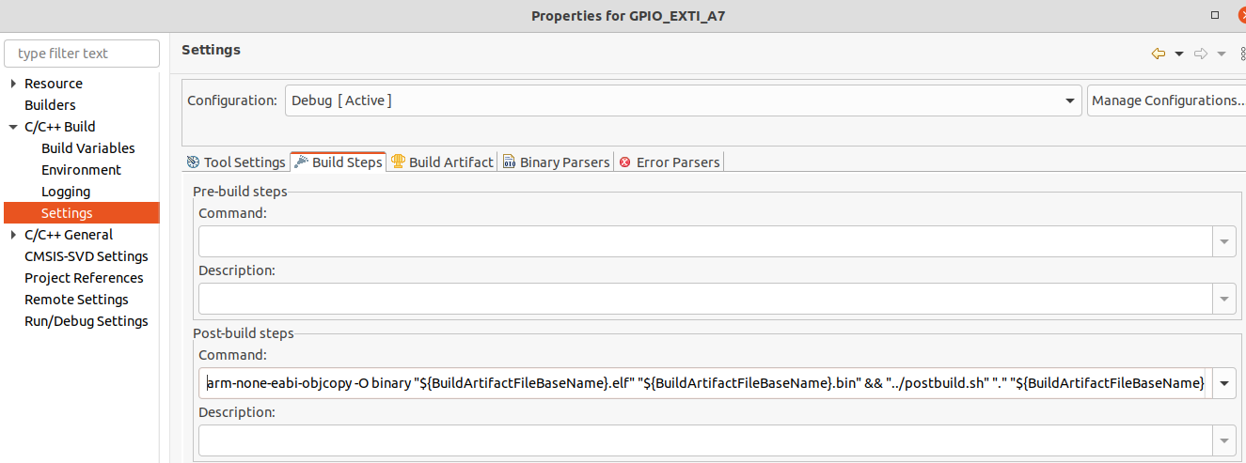
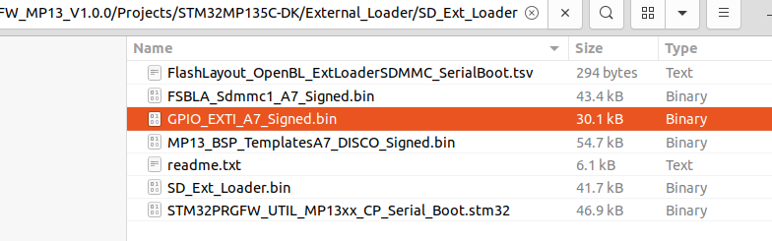
Sign / Copy

Slide 33
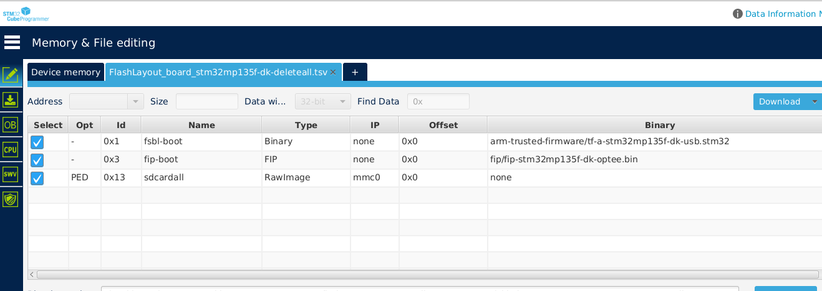
Prep the SD Card on the Platform
The FSBLA needs to be written to a formatted SDCard
There is a "delete all" TSV file included in the starter package that can be used from CubeProgrammer to delete all partitions on the supplied SDCard

Slide 34
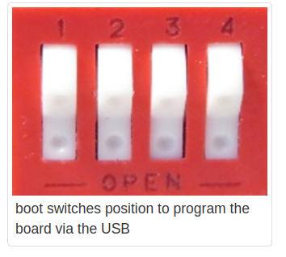
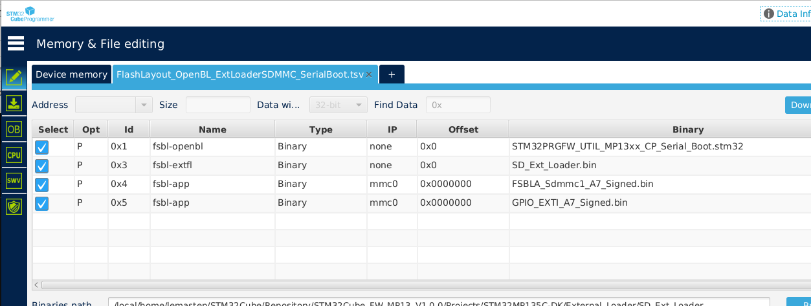
Flash the Application
The FSBLA and Signed Application can now be written to the Formatted SDCard
The supplied Programming Firmware expectes to be connected Via SERIAL port
The USB-C cable connected to CN7 MUST be disconnected for the download to work
Set Boot Pins to all 0 for USB / Serial communication
Connect & Download

Slide 35
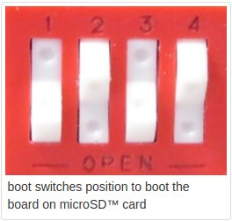
One Thing Left To Do!
Set boot pins back to Boot from SD
Reset the board (Black Button)
Your application starts!
Pressing USER1 button toggles Green LED
Same operation as before
BUT loaded by the FSBLA from the SD Card

Slide 36


You can personalize this
last page with a short link
(ex. www.st.com/shortlink)
You can find a complete list of st.com short links on this page:
http://seo.st.com/toolbox/shortcuts/
Find out more at www.st.com

